Slide 1
CS 499/CS 579: Enterprise Defense
Red Teaming

Slide 2
Overview
Introduction to Red Teaming
Demo!
Exam Review

Slide 3
What is Red Teaming?
Penetration Testing
Focus on exploits
Loud
Red Teaming
APT emulation (via TTPs)
Notes:
Unlike penetration testing – which is typically focused on exploiting vulnerabilities – red teams assess the entire state of a network by emulating real adversaries, including their techniques, tactics, procedures, and goals.

Slide 4
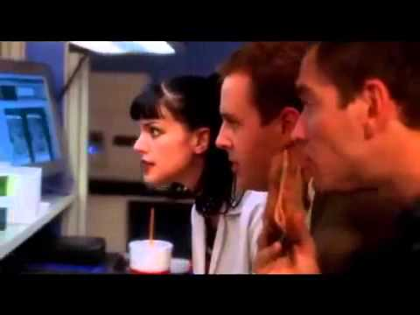
Hacking [1]

Slide 5

Also Hacking [1]

Slide 6
Introducing the Cyber Kill Chain
Created by Lockheed Martin
Purpose: understanding any adversary’s tactics, techniques, and procedures (TTPs)
Specifically for Advanced Persistent Threats (APTs)

Slide 7
Cyber Kill Chain (cont.)
7 critical steps
Intruder succeeds in step 7 if and only if 1-6 are successful
Defender’s ability to detect various stages can be nearly impossible

Slide 8
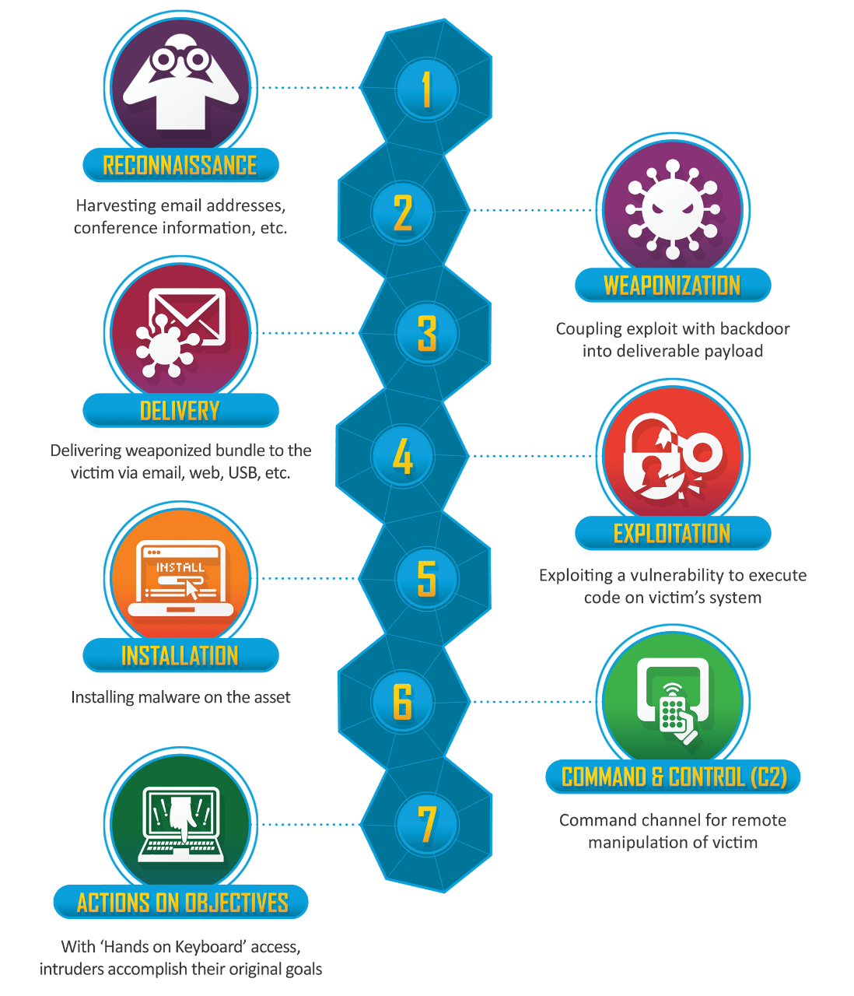
CKC [2]

Slide 9
Step 1 - Reconnaissance (Offensive)
Researching, targeting, identifying
May be searching for companies, people, or devices
Collecting any and all kinds of OSINT pertaining to target

Slide 10
Step 1 - Reconnaissance (Defensive)
How do defenders detect this?
What should be collected?
How to identify the behavior, and prevent it in the future?
Notes:
Examples:
Website logs
Browser analytics — do UAS’s look normal?
Search history on any public-facing websites
Querying Google’s Trends
Build new detections into existing tools (i.e., Snort, Suricate, Zeek…) based on behaviors
Build/use existing detections based on rules

Slide 11
Step 2 - Weaponization (Offensive)
CONOP time —> decide ‘how’
What tool will we use?
Beaconing v. Non-beaconing Implant
File-based (dropper) v. Fileless
How will we do C2? Usually a big discussion
Does it require a wrapper?

Slide 12
Step 2 - Weaponization (Offensive)
Tooling time
Acquire a toolkit
1st party — Build Your Own
2nd party — Buy one… misattributably
3rd party — Steal one

Slide 13
Step 2 - Weaponization (Defensive)
Post-mortem incident response
Understand the why, not just the what
Build a timeline
Full malware analysis
Static (more than just Ghidra/IDA Pro disassembly)
Dynamic (run it in a VM, look for anti-forensics techniques)

Slide 14
Step 2 - Weaponization (Defensive)
After analyzing malware, create new signatures (e.g., YARA rules)
Search out identical signatures*
Sometimes code re-use occurs from tool-to-tool
Tool re-use definitely occurs
Notes:
I think people still use YARA?
Legal things may apply here. I am not saying go hack back.
Tools are made by people. People are lazy.

Slide 15
Step 3 - Delivery (Offensive)
How are we going to deliver our malware package to the target?
Examples?
Notes:
Sending a payload via the Internet to a target’s infrax
Phishing email
Malicious USB
Compromising a website
Compromising a human :)

Slide 16
Step 3 - Delivery (Defensive)
Typically first ‘real’ time defenders can stop an attack
Retroactively understand how payload was delivered
Reverse engineer binaries, net flows, look for artifacts

Slide 17

Step 4 - Exploitation (Offensive) [4]

Slide 18
Step 4 - Exploitation (Offensive)
Hack… something (i.e., take advantage of vulnerabilities):
Physically
Digitally
Human-ly
Known or zero day vulnerability

Slide 19
Step 4 - Exploitation (Offensive)
Two triggering mechanisms:
Adversary, or
Victim
Notes:
Adversary triggers an exploit in a server, for instance.
Victims trigger exploits when clicking links, opening email attachments

Slide 20
Step 4 - Exploitation (Defensive)
How do we prevent people hacking?
How do we prevent RCE and other, related vulnerabilities?
Notes:
People hacking: user training and phishing tests
Secure coding best practices, code reviews, etc. for development (implement as part of SDLC)
Vuln. Scanning (e.g., Nessus) and penetration tests (internal, external)
Hardening — like Brandon mentioned
Principle of Least Privilege
EDR?

Slide 21

Step 5 - Installation (Offensive)
Remember that weird term implant?
Maintain access via installing something
Persistence
Time stomping
Notes:
What kinds of persistence are you familiar with?

Slide 22
Step 5 - Installation (Defensive)
How do we develop an understanding of malware?
What should we be looking for?
What can we install in the future to prevent this?
Notes:
Prevention: HIPS
Malware -> Privileges? User or root?
Any certs w/ the malware?

Slide 23
Step 6 - Command and Control (C2) (Offensive)
Communications!
Typically bidirectional C2
C2 can be done over HTTP(S), DNS, email, FTP, SSH, web services
C2 instance may be adversary-owned, another victim, or an unwitting third party

Slide 24

Step 6 - Command and Control (C2) (Defensive)
Remember WannaCry?
What did Marcus do to stop it?
Notes:
Detection:
Malware analysis leads to C2 instances
How to signature C2? Network comms, server side port, protocol…
Prevention:
Hardening (HIDS, NIDS), traffic logging, and potentially proxying
DNS sink holing — this is how WannaCry was stopped
NS poisoning — can be used by both good and bad guys
OSINT to find similar infrax

Slide 25
Step 7 - Actions on Objectives (Offensive)
CNE v. CNA
Gather up all the things
Priv. Esc.
Movement
Notes:
Anyone want to guess what CNE is? And CNA?
CNA: Disrupt, deny, degrade, destroy, or deceive
CNE: Low and slow hacking

Slide 26
Step 7 - Actions on Objectives (Defensive)
Unless you’ve succeeded before attackers have reached this point… it’s game over.
Notes:
CNA: You should know something happened by now. Maybe not the goal, but it should be evident something occurred.
CNE: Good luck.
Detection: Exile, any movement, credential usage at odd hours. You need to know what’s “normal” on your network. Network capturing.

Slide 27
Demo Time!

Slide 28
Break Time!

Slide 29
Exam Logistics
50 questions
2 points each
1 hr, 45 minute time limit*
Excluding those with accommodations
Code will be given in class at start of class
Via Canvas
Multiple choice & multiple answer

Slide 30
References
[1] YouTube
[2] https://www.lockheedmartin.com/content/dam/lockheed-martin/rms/documents/cyber/Gaining_the_Advantage_Cyber_Kill_Chain.pdf
[3] https://www.mitre.org/sites/default/files/publications/characterizing-effects-cyber-adversary-13-4173.pdf
[4] KnowYourMeme

